Slide 1




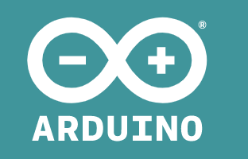





Slide 2


Firewall
Firewall
DMZ
IoT
IoT Controller
ABAP IoT Controller Interact with IoT Devices
HTTPS
API product IoT Controller
Secure tunnel
REST API
HTTPS
Secure tunnel
Event Handler React to events
HTTPS
HTTPS
API product Event handler
Firewall
Secure tunnel
REST API
Secure tunnel
Secure tunnel
HTTPS

